Slide 1
Shortest Path
Bellman Ford and Dijkstra Algorithm

Slide 2
Table of Contents
Introduction
Bellman Ford Algorithm
Dijkstra’s Algorithm
Problem Statement
Converting Maze into graph
Solution using Bellman Ford Algorithm
Solution using Dijkstra’s Algorithm
Time Complexity Comparison
Step Count

Slide 3
Introduction
Shortest Path
If we are searching for the shortest path from node X to any other given node in the graph we need to look at all the possible paths from node X to node Y and pick the shortest.
The shortest path problem is about finding a path between 2 vertices in a graph such that the total sum of the edges weights is minimum.
The two most popular algorithm to find out the shortest path are :
Bellman Ford Algorithm
Dijkstra’s Algorithm

Slide 4
Bellman Ford Algorithm
The Bellman–Ford algorithm is an algorithm that computes shortest paths from a single source vertex to all of the other vertices in a weighted digraph.
It is slower than Dijkstra's algorithm for the same problem, but more versatile, as it is capable of handling graphs in which some of the edge weights are negative numbers.
Bellman Ford algorithm works by overestimating the length of the path from the starting vertex to all other vertices. Then it iteratively relaxes those estimates by finding new paths that are shorter than the previously overestimated paths.
This algorithm takes as input a directed weighted graph and a starting vertex. It produces all the shortest paths from the starting vertex to all other vertices.

Slide 5
Dijkstra’s Algorithm
Dijkstra's algorithm is an algorithm for finding the shortest paths between nodes in a graph.
Set the distance to the source to 0 and the distance to the remaining vertices to infinity.
Set the current vertex to the source.
Flag the current vertex as visited.
For all vertices adjacent to the current vertex, set the distance from the source to the adjacent vertex equal to the minimum of its present distance and the sum of the weight of the edge from the current vertex to the adjacent vertex and the distance from the source to the current vertex.
From the set of unvisited vertices, arbitrarily set one as the new current vertex, provided that there exists an edge to it such that it is the minimum of all edges from a vertex in the set of visited vertices to a vertex in the set of unvisited vertices. To reiterate: The new current vertex must be unvisited and have a minimum weight edges from a visited vertex to it. This can be done trivially by looping through all visited vertices and all adjacent unvisited vertices to those visited vertices, keeping the vertex with the minimum weight edge connecting it.
Repeat steps 3-5 until all vertices are flagged as visited.

Slide 6
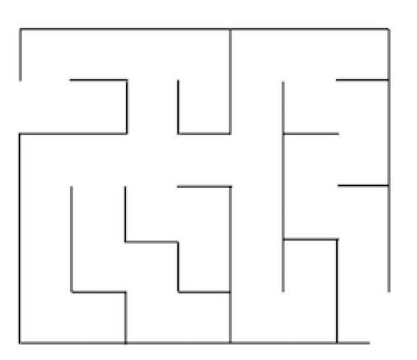
Problem Statement
Use Prim’s Minimum Spanning Tree algorithm and Kruskal’s Minimum Spanning Tree algorithm to find the shortest path of the following maze.

Slide 7
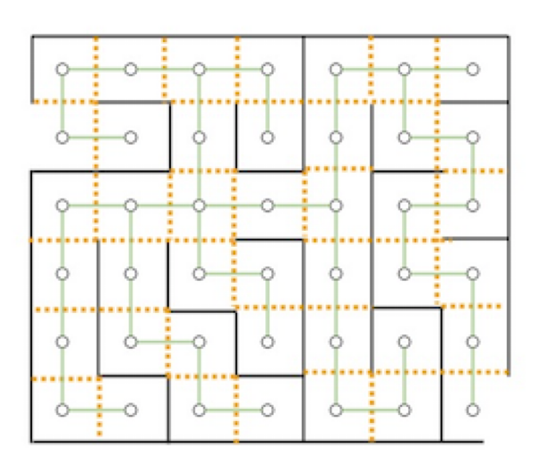
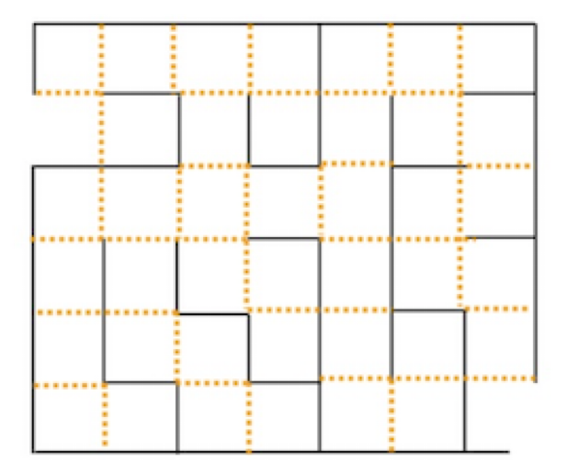
Solution - Converting Maze into Graph
Step 1:
Step 2:

Slide 8
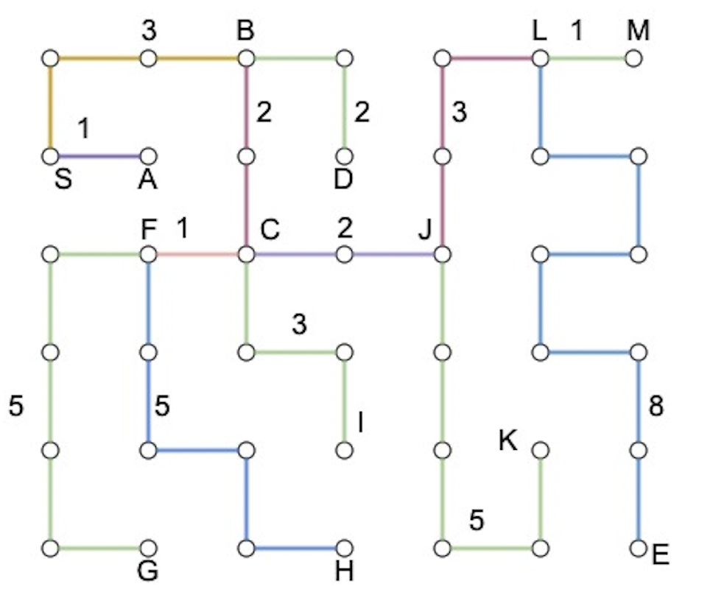
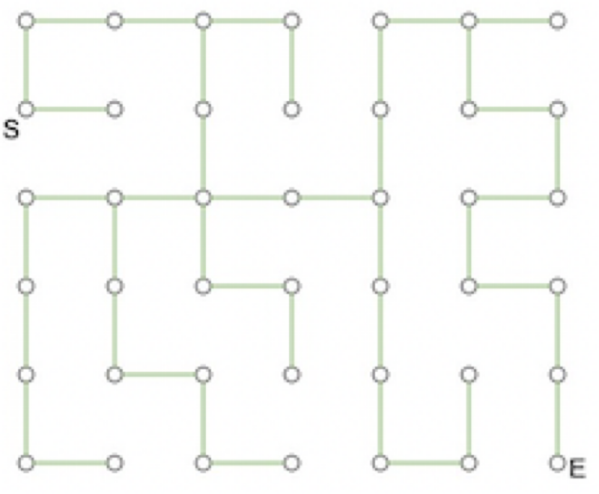
Solution - Converting Maze into Graph (Contd.)
Step 3:
Step 4:

Slide 9
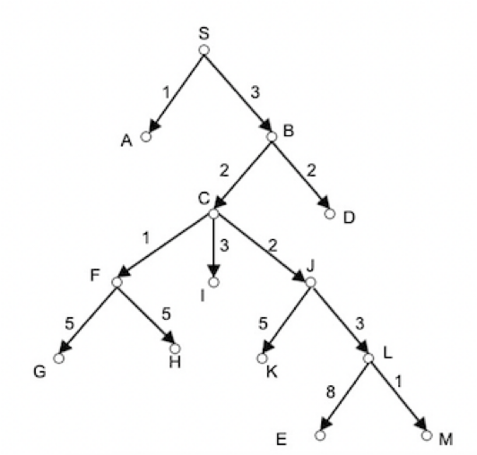
Solution - Converting Maze into Graph (Contd.)
Step 5:

Slide 10
Solution - Using Bellman Ford Algorithm(Contd.)
Cycle 1:
Set all the distances to infinity
Iteration 1:
From S, we can go to A and B.
S—>A = 0+1 = 1
S—>B = 0+3 = 3
0 | ∞ | ∞ | ∞ | ∞ | ∞ | ∞ | ∞ | ∞ | ∞ | ∞ | ∞ | ∞ | ∞
S | A | B | C | D | E | F | G | H | I | J | K | L | M
0 | 1 | 3 | ∞ | ∞ | ∞ | ∞ | ∞ | ∞ | ∞ | ∞ | ∞ | ∞ | ∞
S | A | B | C | D | E | F | G | H | I | J | K | L | M

Slide 11
Solution - Using Bellman Ford Algorithm(Contd.)
Iteration 2:
From A, we can’t go anywhere.
Iteration 3:
From B, we can go to C and D.
B—>C = 3+2 = 5
B—>D = 3+2 = 5
0 | 1 | 3 | ∞ | ∞ | ∞ | ∞ | ∞ | ∞ | ∞ | ∞ | ∞ | ∞ | ∞
S | A | B | C | D | E | F | G | H | I | J | K | L | M
0 | 1 | 3 | 5 | 5 | ∞ | ∞ | ∞ | ∞ | ∞ | ∞ | ∞ | ∞ | ∞
S | A | B | C | D | E | F | G | H | I | J | K | L | M

Slide 12
Solution - Using Bellman Ford Algorithm(Contd.)
Iteration 4:
From C, we can go to F , I and J.
C—>F = 5+1 = 6
C—>I = 5+3 = 8
C—>J = 5+2 = 7
Iteration 5:
From D, we can’t go anywhere.
0 | 1 | 3 | 5 | 5 | ∞ | 6 | ∞ | ∞ | 8 | 7 | ∞ | ∞ | ∞
S | A | B | C | D | E | F | G | H | I | J | K | L | M
0 | 1 | 3 | 5 | 5 | ∞ | 6 | ∞ | ∞ | 8 | 7 | ∞ | ∞ | ∞
S | A | B | C | D | E | F | G | H | I | J | K | L | M

Slide 13
Solution - Using Bellman Ford Algorithm(Contd.)
Iteration 6:
From E, we can’t go anywhere.
Iteration 7:
From F, we can go to G and H
F—>G = 6+5 = 11
F—>H = 6+5 = 11
0 | 1 | 3 | 5 | 5 | ∞ | 6 | ∞ | ∞ | 8 | 7 | ∞ | ∞ | ∞
S | A | B | C | D | E | F | G | H | I | J | K | L | M
0 | 1 | 3 | 5 | 5 | ∞ | 6 | 11 | 11 | 8 | 7 | ∞ | ∞ | ∞
S | A | B | C | D | E | F | G | H | I | J | K | L | M

Slide 14
Solution - Using Bellman Ford Algorithm(Contd.)
Iteration 8:
From G, we can’t go anywhere.
Iteration 9:
From H, we can’t go anywhere.
0 | 1 | 3 | 5 | 5 | ∞ | 6 | 11 | 11 | 8 | 7 | ∞ | ∞ | ∞
S | A | B | C | D | E | F | G | H | I | J | K | L | M
0 | 1 | 3 | 5 | 5 | ∞ | 6 | 11 | 11 | 8 | 7 | ∞ | ∞ | ∞
S | A | B | C | D | E | F | G | H | I | J | K | L | M

Slide 15
Solution - Using Bellman Ford Algorithm(Contd.)
Iteration 10:
From I, we can’t go anywhere.
Iteration 11:
From J, we can go to K and L.
J—>K = 7+5 = 12
J—>L = 7+3 = 10
0 | 1 | 3 | 5 | 5 | ∞ | 6 | 11 | 11 | 8 | 7 | ∞ | ∞ | ∞
S | A | B | C | D | E | F | G | H | I | J | K | L | M
0 | 1 | 3 | 5 | 5 | ∞ | 6 | 11 | 11 | 8 | 7 | 12 | 10 | ∞
S | A | B | C | D | E | F | G | H | I | J | K | L | M

Slide 16
Solution - Using Bellman Ford Algorithm(Contd.)
Iteration 12:
From K, we can’t go anywhere.
Iteration 13:
From L, we can go to E and M.
L—>E= 10+8 = 18
L—>M= 10+1 = 11
0 | 1 | 3 | 5 | 5 | ∞ | 6 | 11 | 11 | 8 | 7 | 12 | 10 | ∞
S | A | B | C | D | E | F | G | H | I | J | K | L | M
0 | 1 | 3 | 5 | 5 | 18 | 6 | 11 | 11 | 8 | 7 | 12 | 10 | 11
S | A | B | C | D | E | F | G | H | I | J | K | L | M

Slide 17
Solution - Using Bellman Ford Algorithm(Contd.)
Iteration 14:
From M, we can’t go anywhere.
0 | 1 | 3 | 5 | 5 | 18 | 6 | 11 | 11 | 8 | 7 | 12 | 10 | 11
S | A | B | C | D | E | F | G | H | I | J | K | L | M

Slide 18
Solution - Using Bellman Ford Algorithm(Contd.)
Cycle 2:
Set all the distances to infinity
Iteration 1:
From S, we can go to A and B.
S—>A = 0+1 = 1
S—>B = 0+3 = 3
0 | 1 | 3 | 5 | 5 | 18 | 6 | 11 | 11 | 8 | 7 | 12 | 10 | 11
S | A | B | C | D | E | F | G | H | I | J | K | L | M
0 | 1 | 3 | 5 | 5 | 18 | 6 | 11 | 11 | 8 | 7 | 12 | 10 | 11
S | A | B | C | D | E | F | G | H | I | J | K | L | M

Slide 19
Solution - Using Bellman Ford Algorithm(Contd.)
Iteration 2:
From A, we can’t go anywhere.
Iteration 3:
From B, we can go to C and D.
B—>C = 3+2 = 5
B—>D = 3+2 = 5
0 | 1 | 3 | 5 | 5 | 18 | 6 | 11 | 11 | 8 | 7 | 12 | 10 | 11
S | A | B | C | D | E | F | G | H | I | J | K | L | M
0 | 1 | 3 | 5 | 5 | 18 | 6 | 11 | 11 | 8 | 7 | 12 | 10 | 11
S | A | B | C | D | E | F | G | H | I | J | K | L | M

Slide 20
Solution - Using Bellman Ford Algorithm(Contd.)
Iteration 4:
From C, we can go to F , I and J.
C—>F = 5+1 = 6
C—>I = 5+3 = 8
C—>J = 5+2 = 7
Iteration 5:
From D, we can’t go anywhere.
0 | 1 | 3 | 5 | 5 | 18 | 6 | 11 | 11 | 8 | 7 | 12 | 10 | 11
S | A | B | C | D | E | F | G | H | I | J | K | L | M
0 | 1 | 3 | 5 | 5 | ∞ | 6 | ∞ | ∞ | 8 | 7 | ∞ | ∞ | ∞
S | A | B | C | D | E | F | G | H | I | J | K | L | M

Slide 21
Solution - Using Bellman Ford Algorithm(Contd.)
Iteration 6:
From E, we can’t go anywhere.
Iteration 7:
From F, we can go to G and H
F—>G = 6+5 = 11
F—>H = 6+5 = 11
0 | 1 | 3 | 5 | 5 | 18 | 6 | 11 | 11 | 8 | 7 | 12 | 10 | 11
S | A | B | C | D | E | F | G | H | I | J | K | L | M
0 | 1 | 3 | 5 | 5 | 18 | 6 | 11 | 11 | 8 | 7 | 12 | 10 | 11
S | A | B | C | D | E | F | G | H | I | J | K | L | M

Slide 22
Solution - Using Bellman Ford Algorithm(Contd.)
Iteration 8:
From G, we can’t go anywhere.
Iteration 9:
From H, we can’t go anywhere.
0 | 1 | 3 | 5 | 5 | 18 | 6 | 11 | 11 | 8 | 7 | 12 | 10 | 11
S | A | B | C | D | E | F | G | H | I | J | K | L | M
0 | 1 | 3 | 5 | 5 | 18 | 6 | 11 | 11 | 8 | 7 | 12 | 10 | 11
S | A | B | C | D | E | F | G | H | I | J | K | L | M

Slide 23
Solution - Using Bellman Ford Algorithm(Contd.)
Iteration 10:
From I, we can’t go anywhere.
Iteration 11:
From J, we can go to K and L.
J—>K = 7+5 = 12
J—>L = 7+3 = 10
0 | 1 | 3 | 5 | 5 | 18 | 6 | 11 | 11 | 8 | 7 | 12 | 10 | 11
S | A | B | C | D | E | F | G | H | I | J | K | L | M
0 | 1 | 3 | 5 | 5 | 18 | 6 | 11 | 11 | 8 | 7 | 12 | 10 | 11
S | A | B | C | D | E | F | G | H | I | J | K | L | M

Slide 24
Solution - Using Bellman Ford Algorithm(Contd.)
Iteration 12:
From K, we can’t go anywhere.
Iteration 13:
From L, we can go to E and M.
L—>E= 10+8 = 18
L—>M= 10+1 = 11
0 | 1 | 3 | 5 | 5 | 18 | 6 | 11 | 11 | 8 | 7 | 12 | 10 | 11
S | A | B | C | D | E | F | G | H | I | J | K | L | M
0 | 1 | 3 | 5 | 5 | 18 | 6 | 11 | 11 | 8 | 7 | 12 | 10 | 11
S | A | B | C | D | E | F | G | H | I | J | K | L | M

Slide 25
Solution - Using Bellman Ford Algorithm(Contd.)
Iteration 14:
From M, we can’t go anywhere
Since, in this cycle no weights were updated, the process will stop here.
Hence, the weight of the shortest path from S to E is 18.
.
0 | 1 | 3 | 5 | 5 | 18 | 6 | 11 | 11 | 8 | 7 | 12 | 10 | 11
S | A | B | C | D | E | F | G | H | I | J | K | L | M

Slide 26
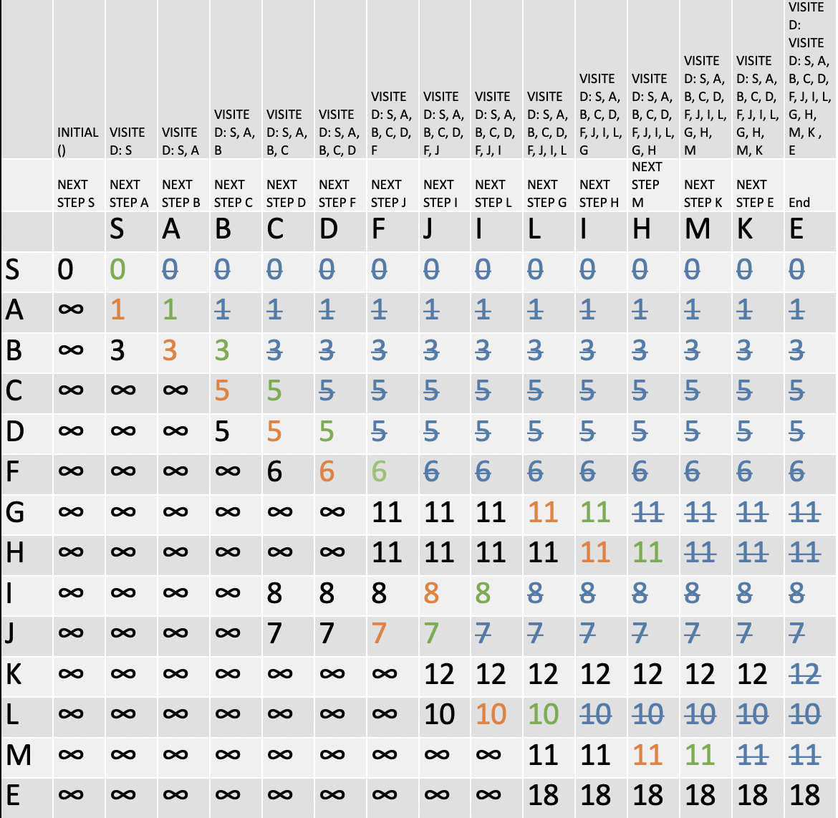
Solution - Using Dijkstra Algorithm
V: the current visiting node
V: the next node to visit
V: this node has been visited
The shortest path from S to E has weight 18.(S—> B—> C—> J—> L—>E)

Slide 27
Comparison of Big O of Bellman and Dijkstra Algorithm
Time Complexity of Dijkstra:
The complexity of this algorithm is fully dependent on the implementation of Extract-Min function.
If extract min function is implemented using linear search, the complexity of this algorithm is O(V² + E).
A typical binary heap priority queue implementation has O((|E|+|V|)log|V|) time complexity.
Time Complexity of Bellman Ford: O(|V||E|) complexity
If we use Dijkstra with binary heap , the performance of this algorithm is much better than Bellman Ford. But Dijkstra has one big disadvantage that it cannot handle negative weights. Hence, in that case Bellman is used.
But if there no negative weights in the graph Dijkstra is always preferred over Bellman.

Slide 28
Step Count
A step is defined as either comparing two numbers or replacing a number.
No of step counts in Bellman Ford in all the cycles: 13 (no of replacements)
No of step counts in Dijkstra: 13 (no of replacements)
Since the graph is sparse and there are no cycles , the step count for both the algorithm is same.

Slide 29
Thank You

